Slide 1

Real Estate Insights: Predictive Analytics for Airbnb and Zillow Listings
By Group 3
Aradhya Alva Rathnakar, Bhavan Kumar Basavaraju, Mahamaya Panda, Shashi Kumar Kadari Mallikarjuna
Department of Applied Data Science, San Jose State University
Data 240: Data Mining
Professor: Shayan Shams
Date: May 9, 2024

Slide 2

Motivation/Background
Financial security is crucial as retirement approaches. Real estate investment, alongside 401(k)s and IRAs, offers rental income and property appreciation to hedge against inflation.
Identifying prime markets and properties requires thorough research. Utilizing Airbnb and Zillow data with machine learning and advanced techniques can optimize returns from short-term rentals and long-term holdings.
Data-driven insights on neighborhoods, attributes, and pricing enhance financial planning, empowering individuals for informed property investment and bolstering retirement readiness.

Slide 3
Objectives
Enhanced Market Insights: Use Airbnb and Zillow data to spot profitable real estate investments, leveraging rental pricing and property values for optimized returns.
Predictive Modeling: Create machine learning models to predict Airbnb rental prices and Zillow home values, empowering data-driven property investment decisions.
Strategic Investment Outcomes: Forge a strong connection between rental rates and property values, offering actionable advice for customers and property owners to navigate future market conditions effectively.

Slide 4
Literature Review
Serial No | Technique Used | Dataset Used | Approach | Pros | Cons | Results
[1] | Linear Regression, Naive Bayes, Logistic Regression, KNN, Decision Tree, Gradient Boosting | Airbnb listing data from New York City from 2011-2019 containing 48895 rows and 16 columns | 1. Analyzed linear relationship between target and input features to find best fit line. 2. Classified price into categories using Bayes theorem, logit function and similarity to neighbors. 3. Split the data into subsets based on attribute test. 4. Ensemble technique that combines multiple decision trees in a stage-wise fashion | 1. Assumes linearity and independence, with the choice of k being critical. 2. It's computationally intensive, prone to overfitting, yet simple to implement and interpret. 3. It handles both numeric and categorical data without making prior assumptions, offering flexibility and often achieving high accuracy. | 1. Outliers and noise may impact. 2. Works only for categorical predictors. 3. May overfit easily. May overfit data. 4. Overfitting is also possible if boosting is excessive. | 1. The paper compared techniques like Linear Regression, SVM, XGBoost, and DNN on the Airbnb dataset containing listing, reviews, and location data. 2. XGBoost with adjusted hyperparameters performed best with the highest R2 score of 0.4768 and lowest RMSE of 0.4647 for price prediction task, demonstrating the effectiveness of leveraging multi-modality data.
[2] | XGBoost Regressor with Hyperparameter tuning, DNN, NLP, PCA, Spectral Clustering | Listings data, Reviews data, Neighborhood/Geo data from Inside Airbnb for 10 cities | 1. Combined multi-modal data (text, numeric, location) as features into machine learning models to predict Airbnb prices. 2. Applied NLP to reviews, PCA for dimension reduction, clustering for distances to landmarks. | 1. Leveraging various data sources and techniques achieved best performance. 2. Combined approaches addressed limitations of single data types. | 1. Only used one data source (Inside Airbnb). 2. Performance could be further improved by expanding data scope and optimizing models. | 1. The research developed an Airbnb price prediction model leveraging multi-modality data (listings, reviews, locations) through techniques like NLP, PCA, clustering. 2. Achieved best performance with XGBoost compared to other models.
[3] | DeepAR, Fuzzy Time Series, LSTM, Multiple Linear Regression, NBEATS, Support Vector Regression, Temporal Fusion Transformers | Dark Sky API (weather), Solar Flare (space), UCI Electricity Load | 1. The study compares seven advanced time series prediction methods. Using three datasets—Dark Sky weather data, MVTS solar flare data, and UCI electricity load data—each model's performance is evaluated based on metrics like RMSE, MSE, MAE, R-squared, and computational efficiency. 2. The goal is to pinpoint the most accurate and efficient forecasting approach across different domains. | 1. Handle variety of problems, scales,seasonality. 2. Provide accuracy, easy implementation, leverage past history | Computationally expensive, assume linearity, require large datasets, complex architectures, lower performance than top models | 1. The results showed that NBEATS outperformed other models with the best RMSE, MSE, and MAE values on most datasets. 2. LSTM performed best in terms of accuracy (R-squared) on weather data and computation time, and DeepAR and TFT also exhibited good overall performance.
[4] | Linear Regression, Random Forest, and XGBoost | 2023 Airbnb US listing data | The technical approach involved applying all the three models and XGBoost was tuned using GridSearchCV and cross-validation, to predict Airbnb listing prices based on evaluating model performance using various metrics and visualizations. | 1. XGBoost model achieved the highest prediction accuracy with the lowest error rates and explained the highest proportion of variance in prices. | 1. More complex than linear models so harder to directly interpret predictions. 2. Only three main models were evaluated so room for testing more advanced techniques. | 1. The results showed that the tuned XGBoost model achieved the highest prediction accuracy with the lowest error rates 2. Also explained the highest proportion of variance in Airbnb listing prices compared to the other models.

Slide 5


Dataset Description
Inside Airbnb: Provides listing-level data for Airbnb properties in various cities.
Details include amenities, reviews, and booking history.
Data Size: 319.7 MB
Source: Inside Airbnb
Zillow Research: Offers housing market metrics and property sales data at different geographic levels.
Data Size: 160.3 MB
Source: Zillow Research

Slide 6
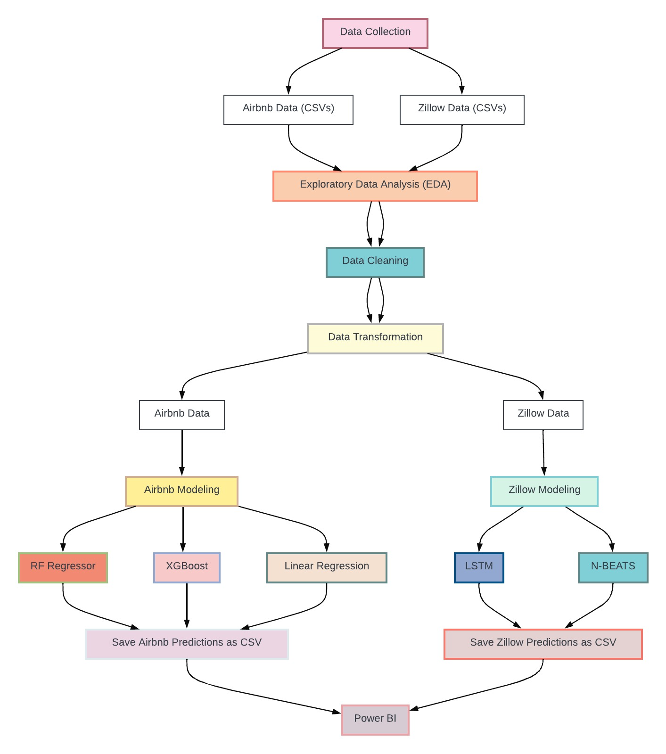
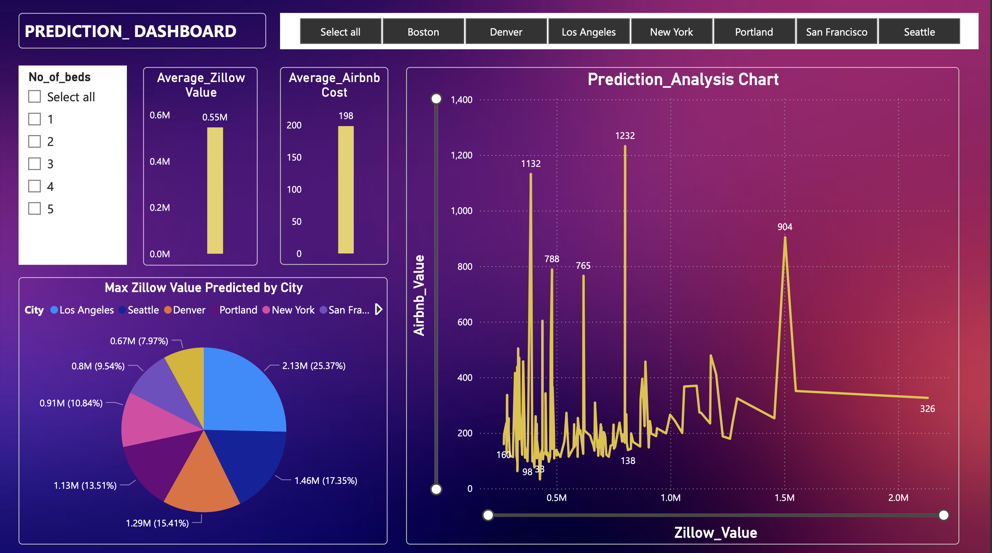
Methodology

Slide 7
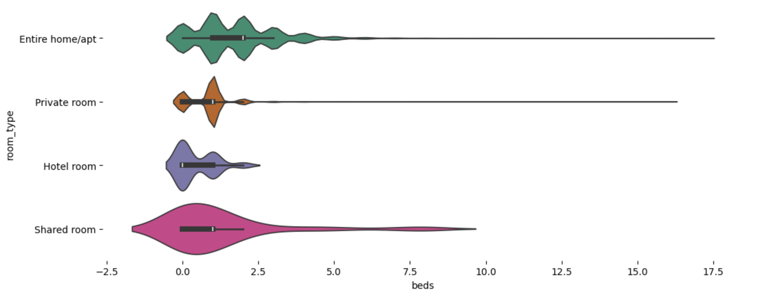
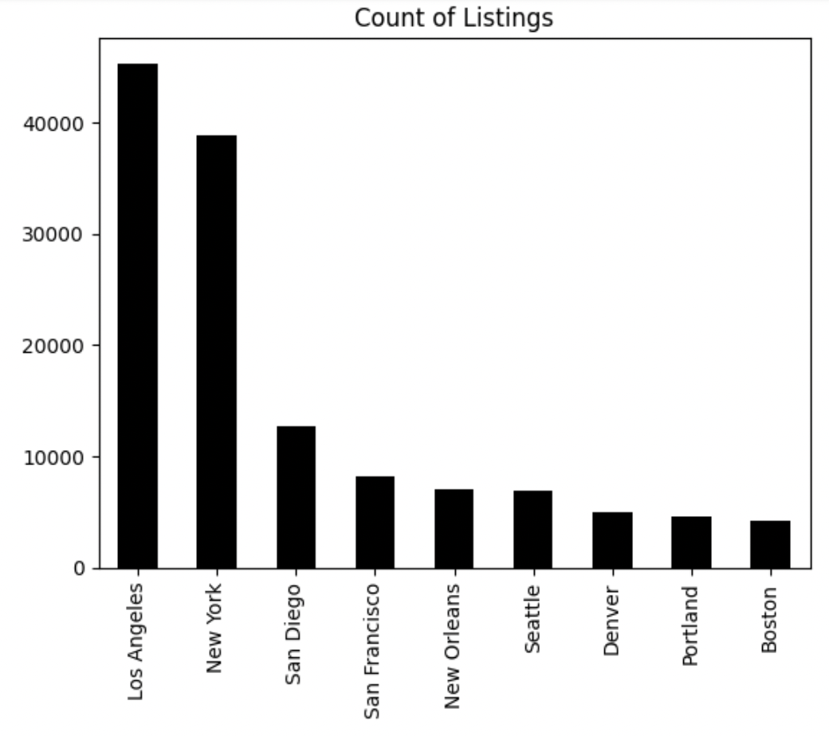
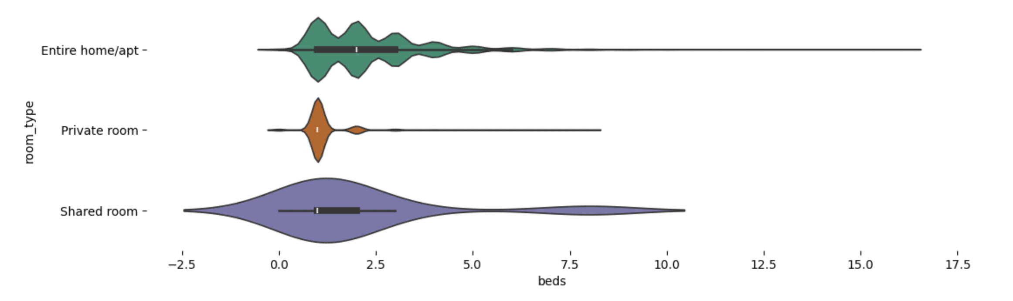
Exploratory Data Analysis – Airbnb Dataset
San Francisco
Seattle

Slide 8
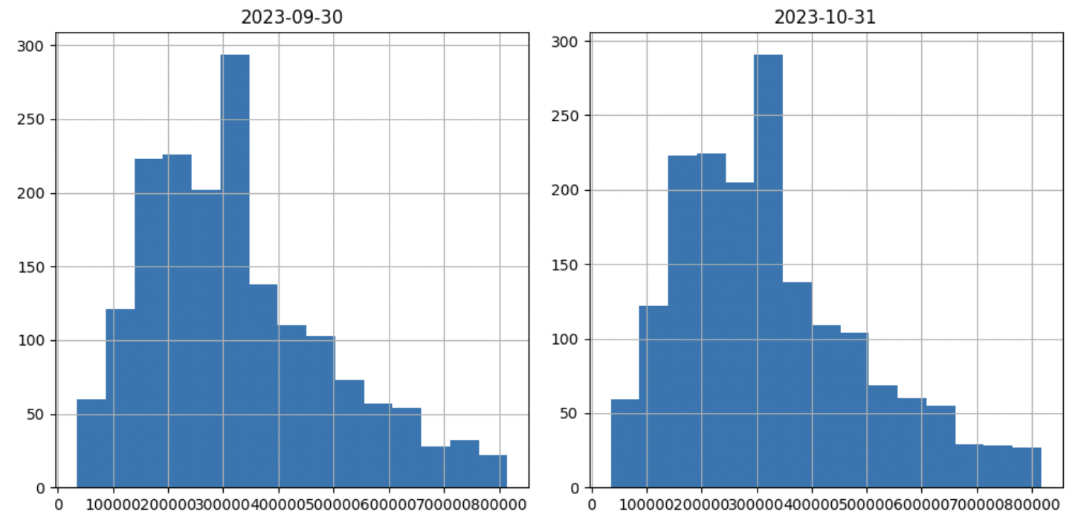
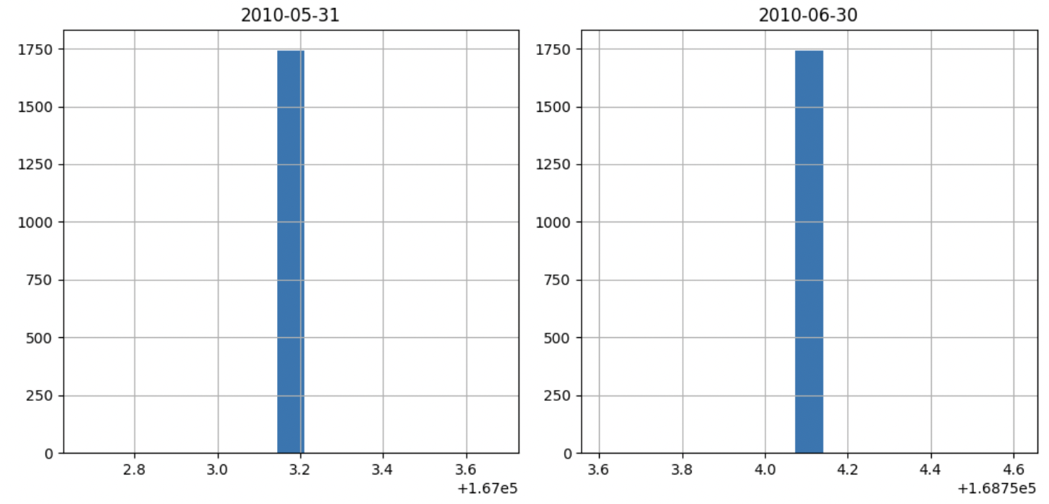
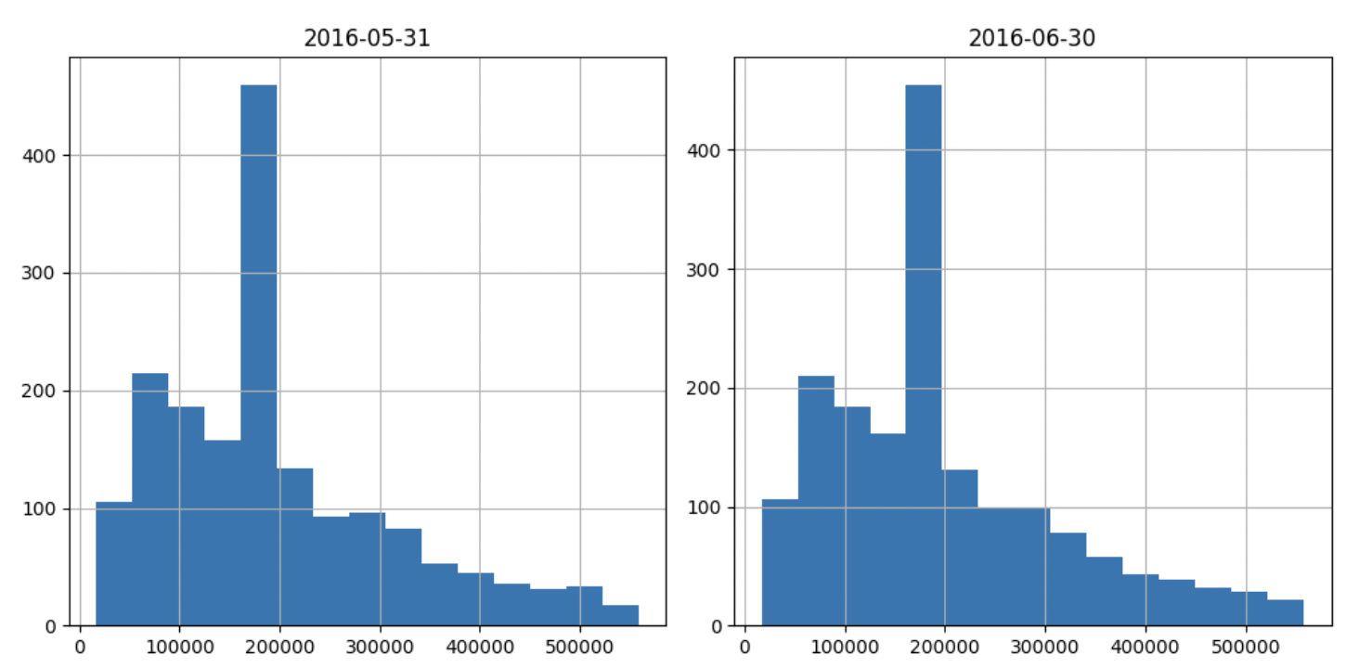
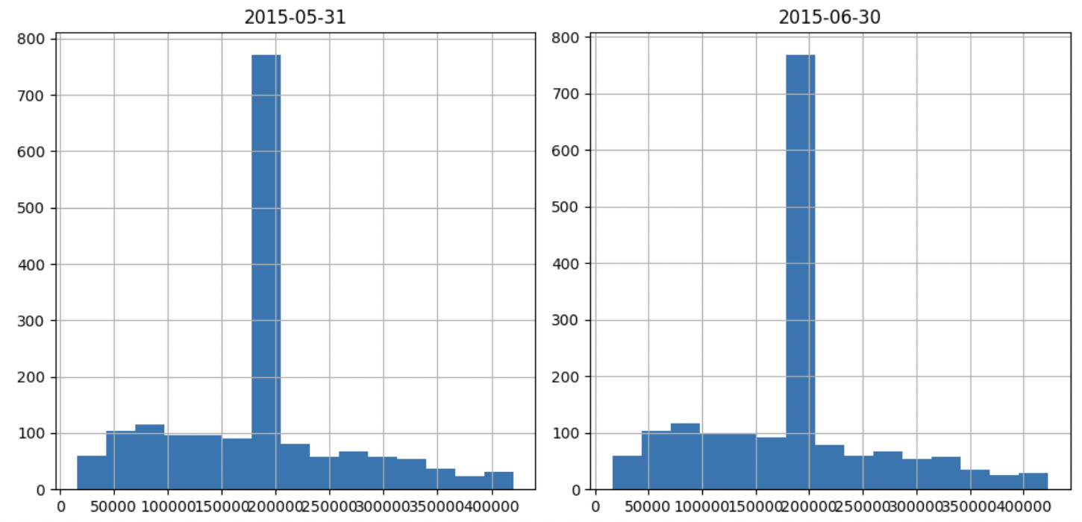
Exploratory Data Analysis – Zillow Dataset
Histograms for all numeric columns are generated in the data frame, organizing them neatly in subplots with up to 4 histograms per row.
This facilitates visual inspection and comparison of the distributions of different numeric features in the dataset.

Slide 9
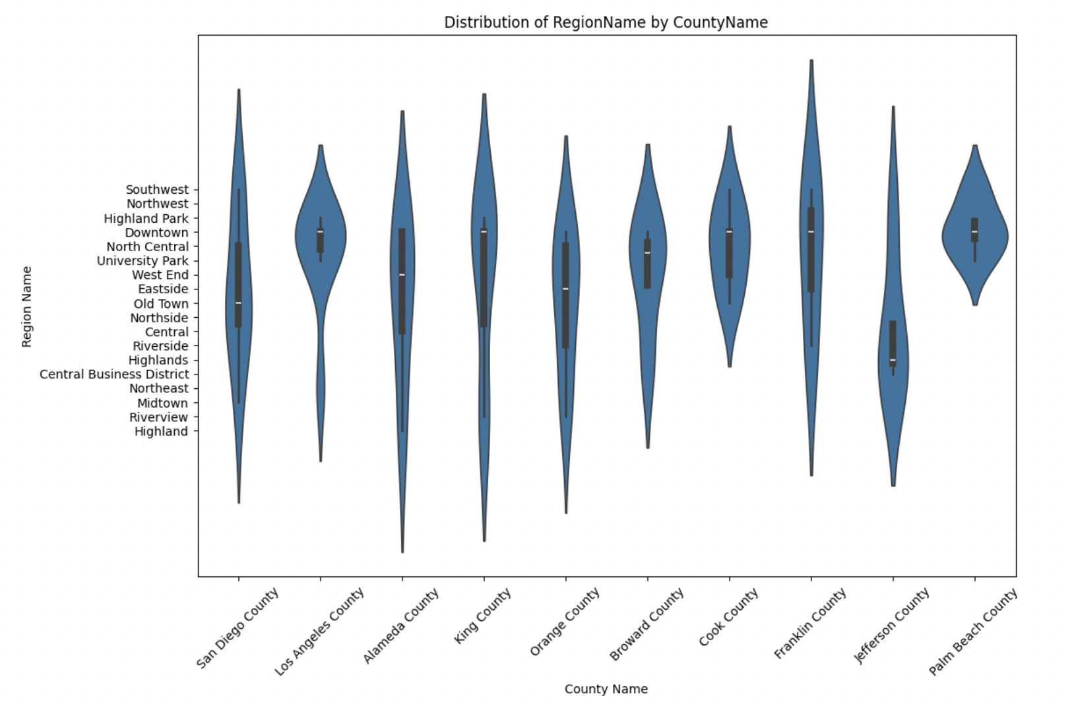
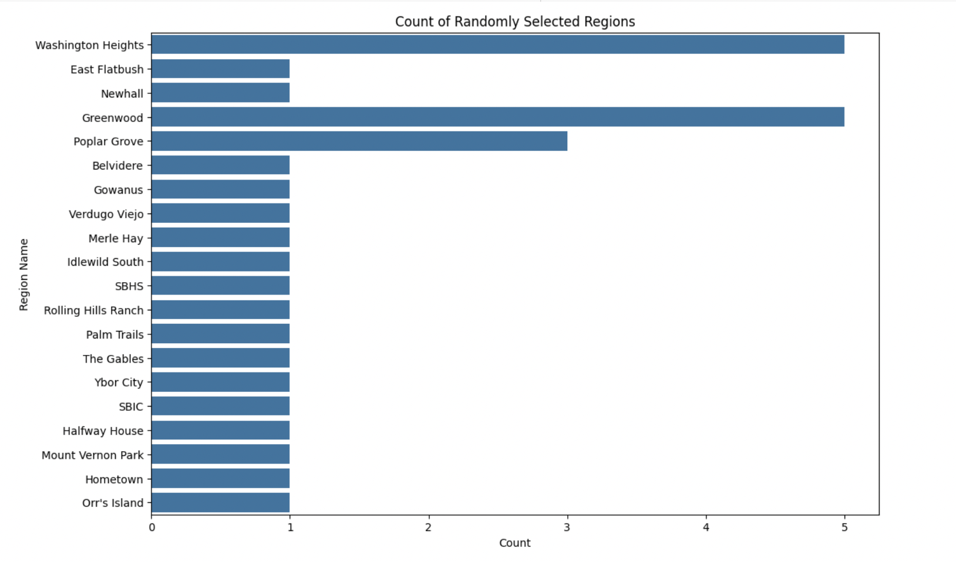
Exploratory Data Analysis – Zillow Dataset
The violin plot illustrates the distribution of Region_Name within the selected top counties, analyzing housing price differences by region within counties.
The bar plot displays the count of randomly chosen regions, giving insight into their distribution within the dataset.

Slide 10
Data Pre-processing
Handling Missing Data:
NUMERIC: Mean and mode imputation
Outlier Detection and Handling:
IQR METHOD
Replace outliers outside the bounds with NaN.
Fill NaN values with the median of that column.
Transformation:
Dropping redundant columns, addition of new columns and datatype corrections
Combine different city data as one Airbnb_data and combine different bedrooms data into a single data frame called zillow_data.
CATEGORICAL: KNN Imputation
Feature Engineering by standardizing numerical features and encoding categorical features

Slide 11
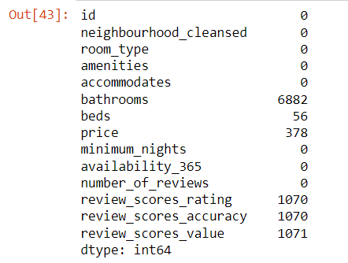
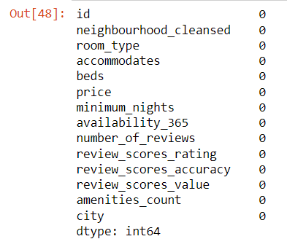
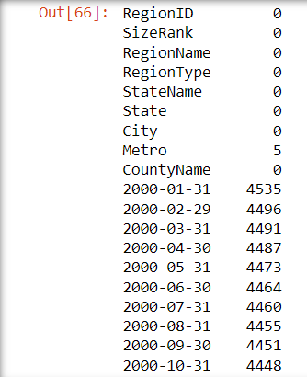
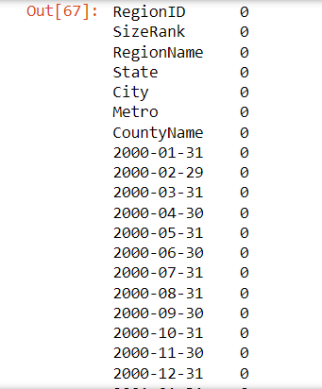
Data Pre-processing
Airbnb_data :
Before:
After:
Zillow_data :
Before:
After:

Slide 12
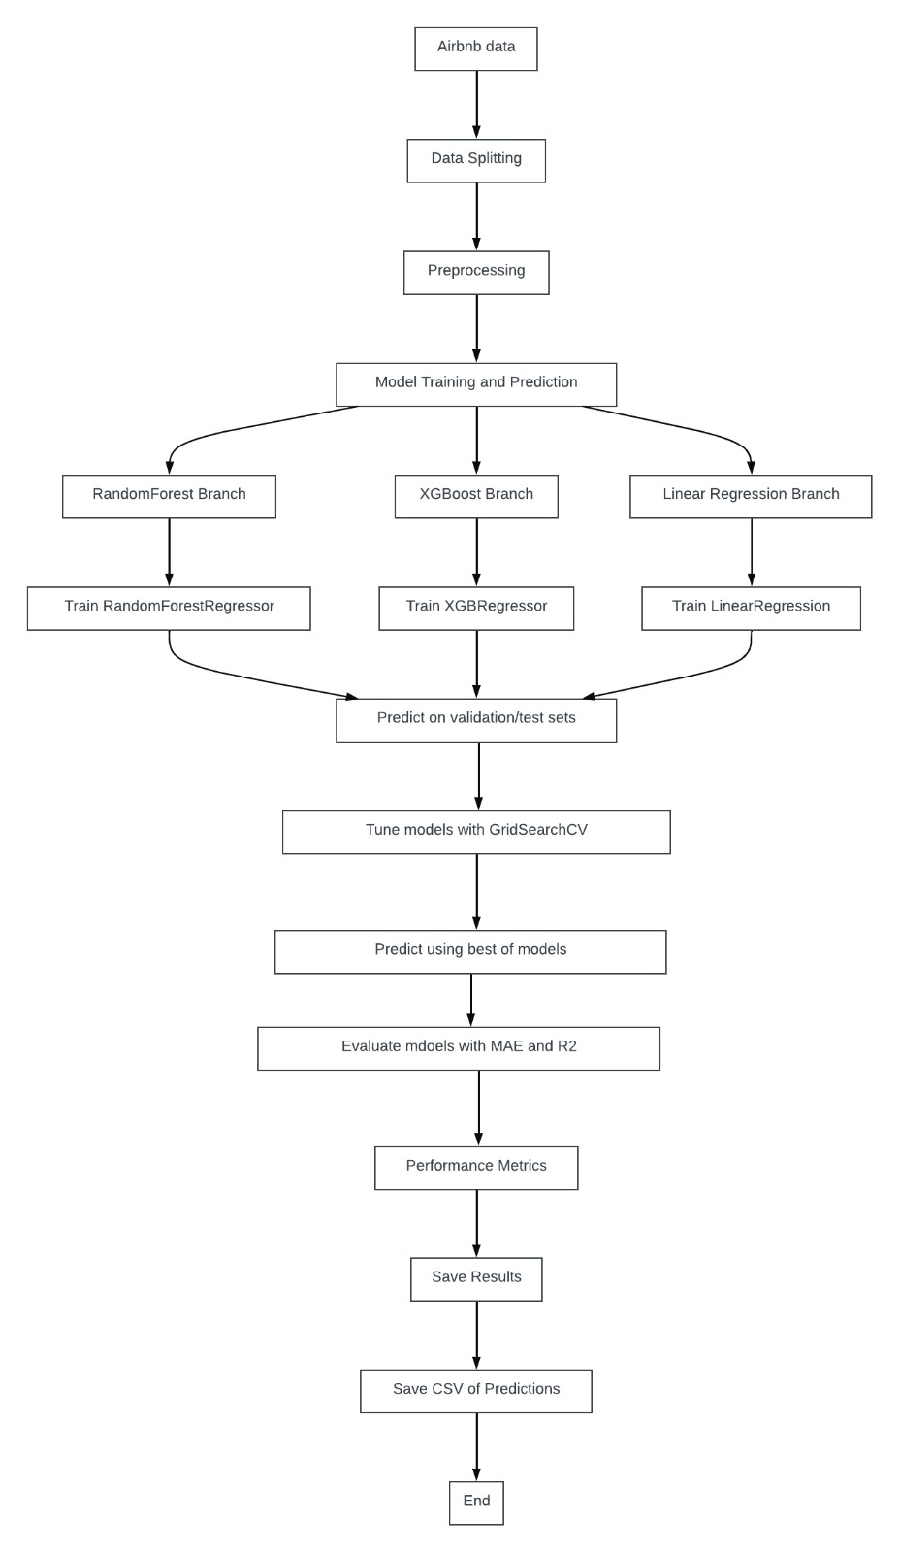
Airbnb Price Prediction: Model Workflow
Data Split: Train: 70, Valid:15, Test:15
Models Used: Linear Regression, Random Forest Classifier, XG-Boost
Best Model: Random Forest Regressor
Regressor_n_estimators: 750

Slide 13
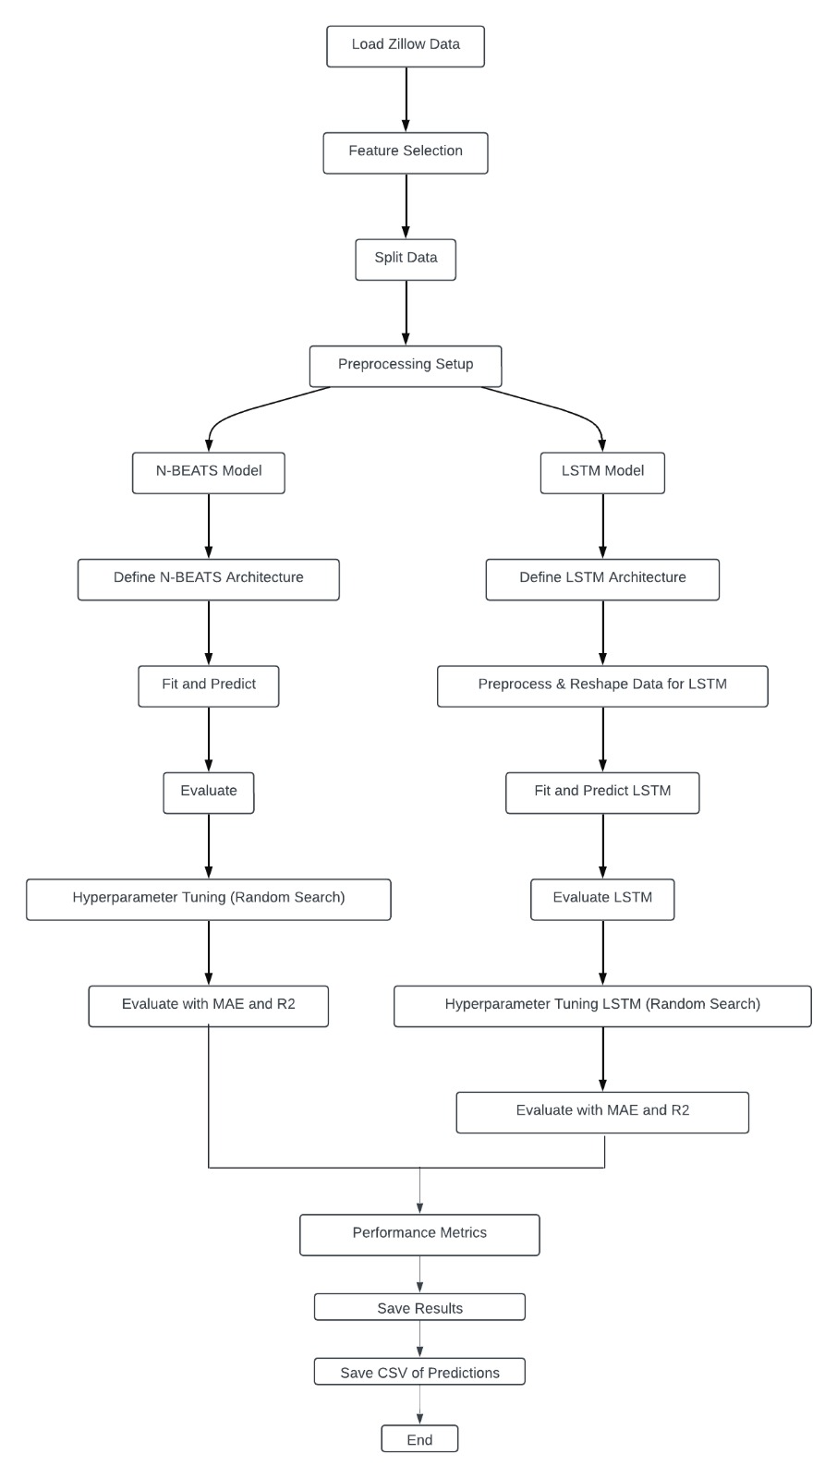
Zillow Home Value Prediction: Model Workflow
Data Split: Train: 70, Valid:15, Test:15
Models Used: N-Beats, LSTM
Best Model: N-Beats
Epochs Size: 250 (25 Max trails for 100 epochs)

Slide 14
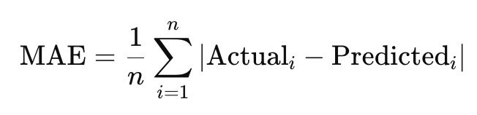

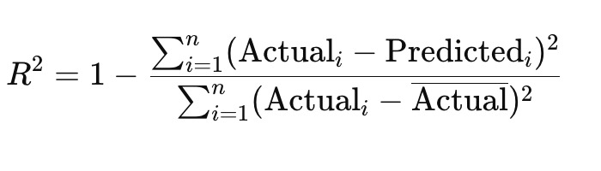
Evaluation Metrics
To evaluate the performances of the models used on validation and test datasets:
Mean Absolute Error (MAE):
Offers a clear, interpretable measure of average prediction error in real estate pricing.
R-squared (R²):
Indicates the proportion of variance in housing prices explained by the model, relative to simple benchmarks.

Slide 15
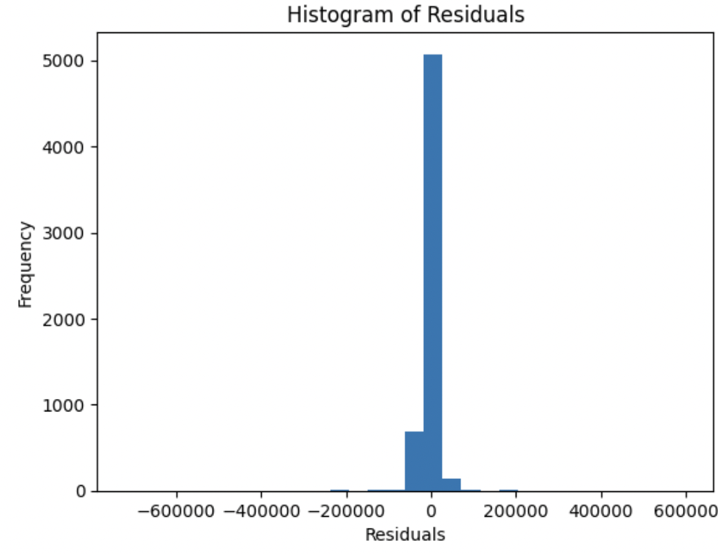
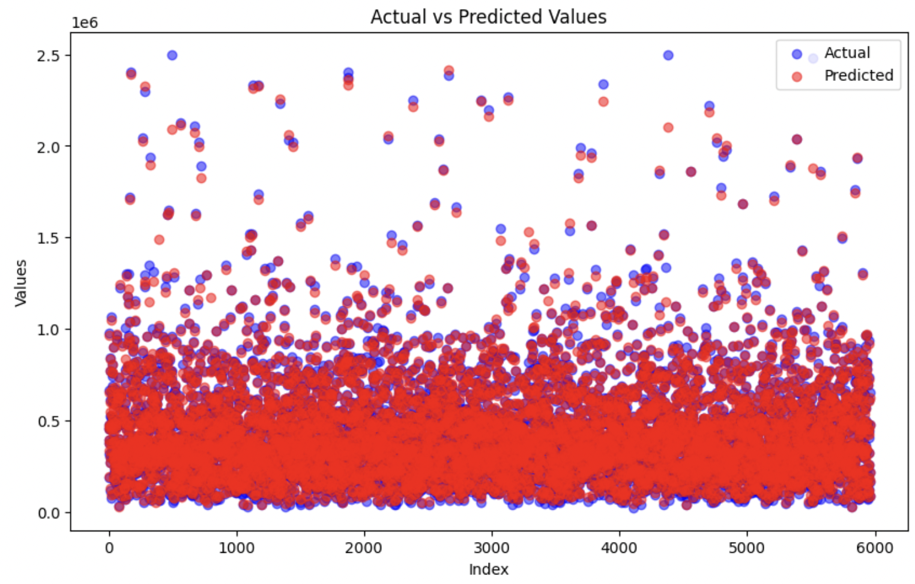
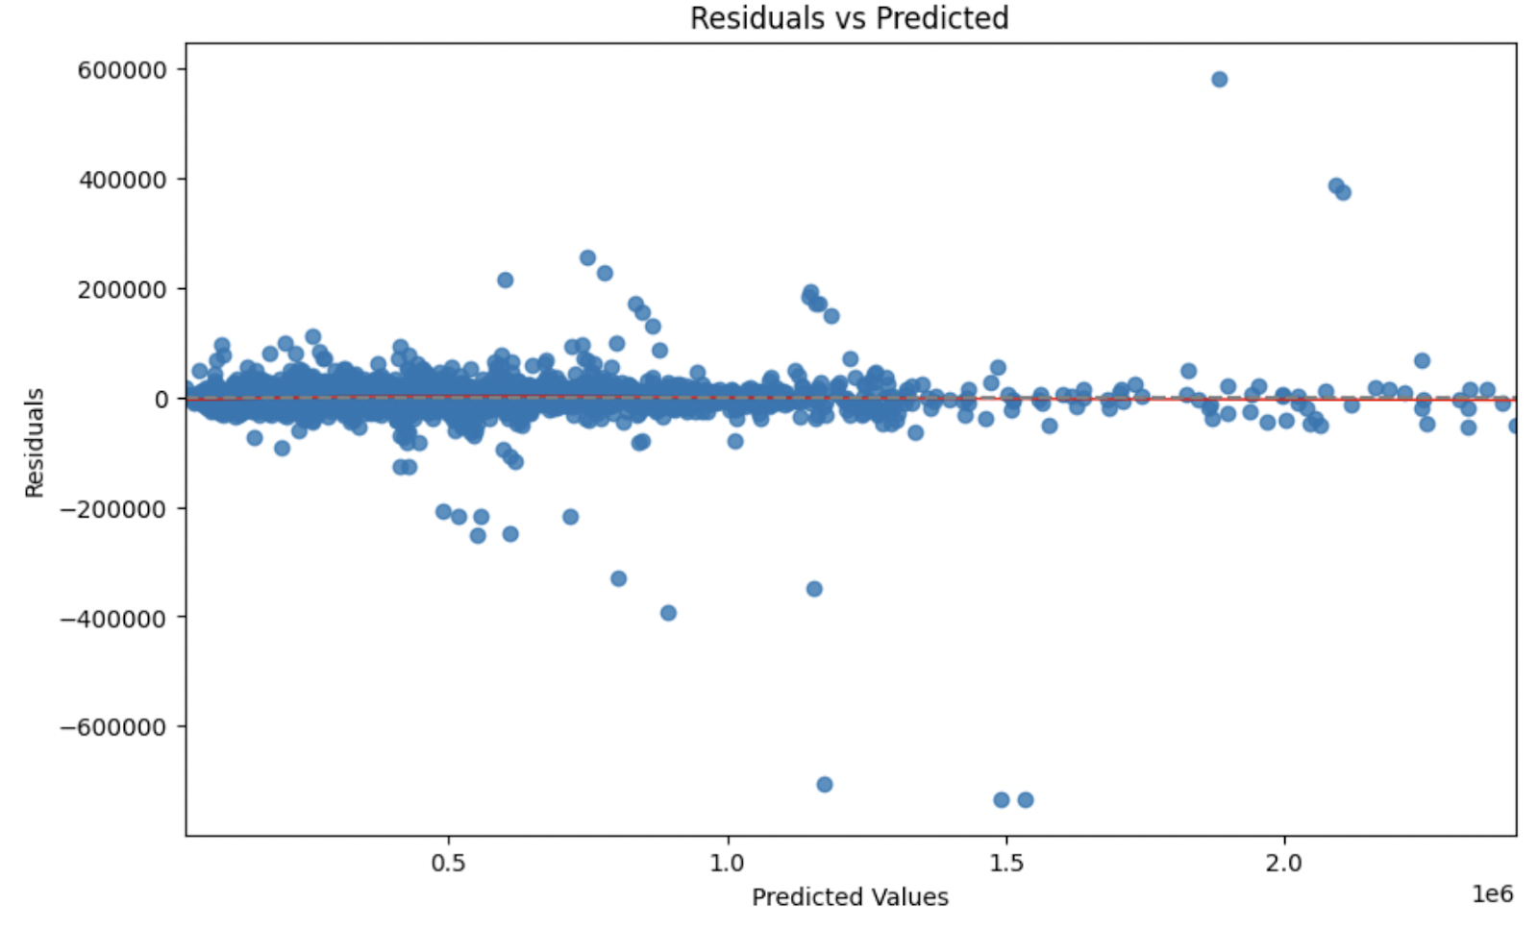
Model Performance Analysis and Metric Preference
Residual Analysis: Residual plot and histogram to explore residuals' relationship with predicted values and their distribution.
Performance Visualization: Scatter plot of actual vs. predicted values to assess model performance, followed by reshaping arrays and calculating residuals.
Metric Preference: MAE is favored over MSE for its straightforward interpretation and reduced sensitivity to outliers, providing clear, average prediction error insights.

Slide 16
Model Comparison with Evaluation Metrics
AIRBNB
Model | Metric | Before Hypertuning | After Hypertuning
Linear Regression | MAE (Test) | 148.277 | 146.636
Linear Regression | MAE (Valid) | 152.625 | 146.636
Linear Regression | R2 (Test) | 0.121 | 0.129
Linear Regression | R2 (Valid) | 0.09 | 0.107
Random Forest Regressor | MAE (Test) | 102.965 | 101.609
Random Forest Regressor | MAE (Valid) | 108.843 | 106.459
Random Forest Regressor | R2 (Test) | 0.055 | 0.333
Random Forest Regressor | R2 (Valid) | 0.012 | 0.186
XGBoost | MAE (Test) | 114.708 | 126.667
XGBoost | MAE (Valid) | 118.032 | 132.166
XGBoost | R2 (Test) | 0.105 | 0.223
XGBoost | R2 (Valid) | 0.025 | 0.151
ZILLOW
Model | Metric | Before Hypertuning | After Hypertuning
N-BEATS | MAE (Test) | 165570.15 | 24378.49
N-BEATS | MAE (Valid) | 163999.041 | 24148.658
N-BEATS | R2 (Test) | 0.452 | 0.978
N-BEATS | R2 (Valid) | 0.414 | 0.966
LSTM | MAE (Test) | 437771.81 | 435140.62
LSTM | MAE (Valid) | 430513.728 | 430513.728
LSTM | R2 (Test) | 0.274 | 0.247
LSTM | R2 (Valid) | 0.245 | 0.372

Slide 17
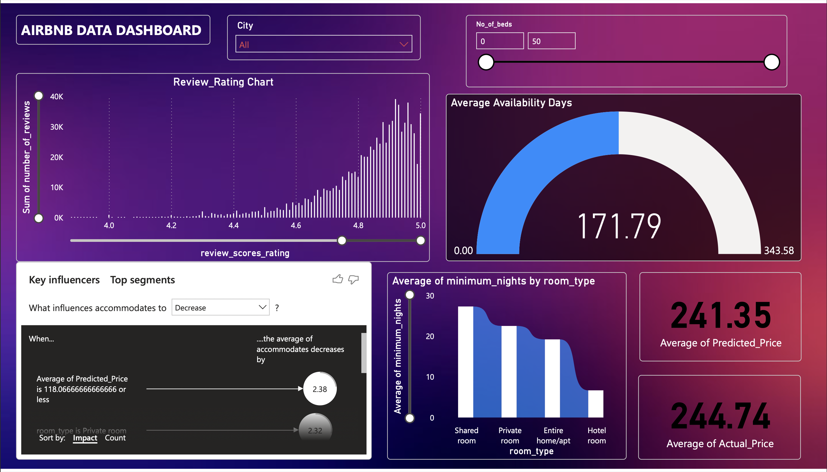
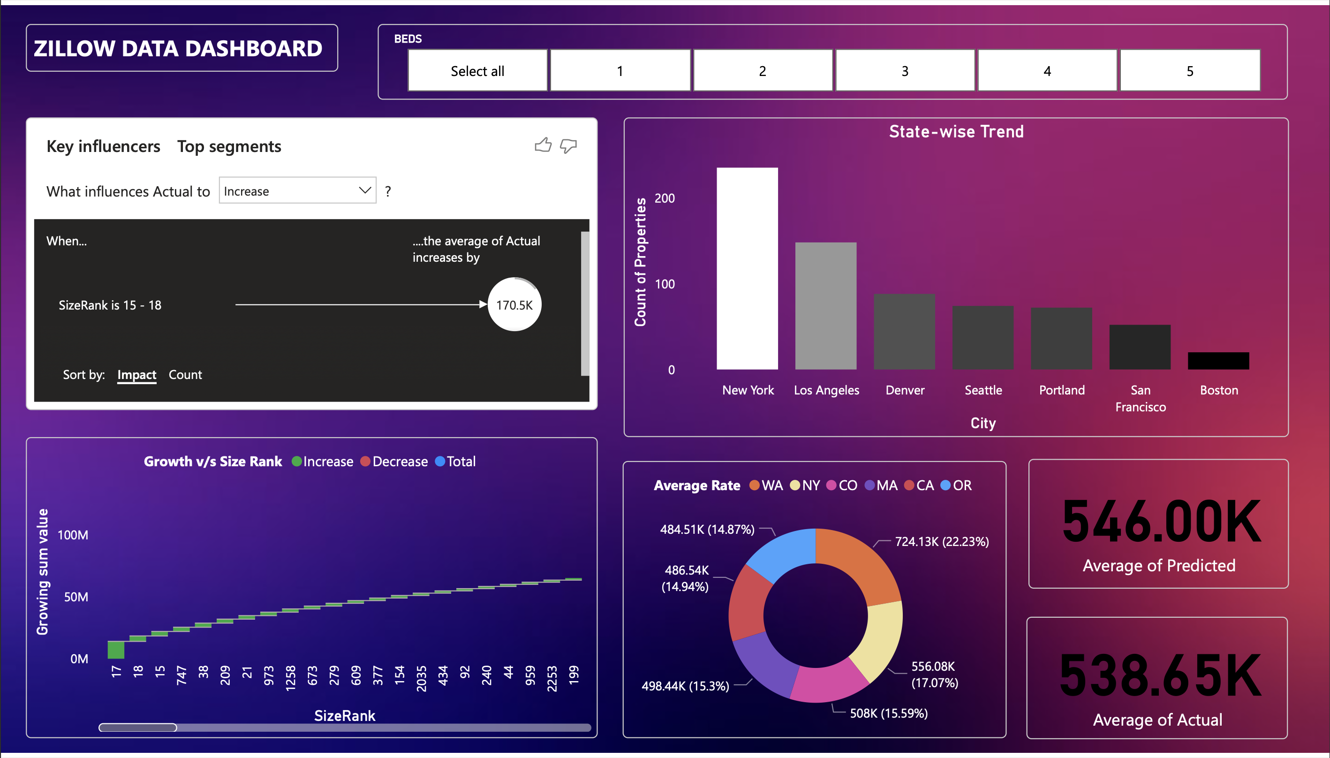
In-Depth Analysis: Zillow and Airbnb
AIRBNB DASHBOARD: Airbnb Dashboard
Indicates an increase in listings as the number of beds and review ratings increase across cities
review_scores_rating impacts average availability days and shared rooms having the highest average minimum nights.
ZILLOW DASHBOARD: Zillow Dashboard
Filters property data by the number of beds.
The SizeRank positively influences sales prices; New York, Los Angeles, and Denver lead property growth;
Properties with SizeRank 17-199 exhibit the highest average value.

Slide 18
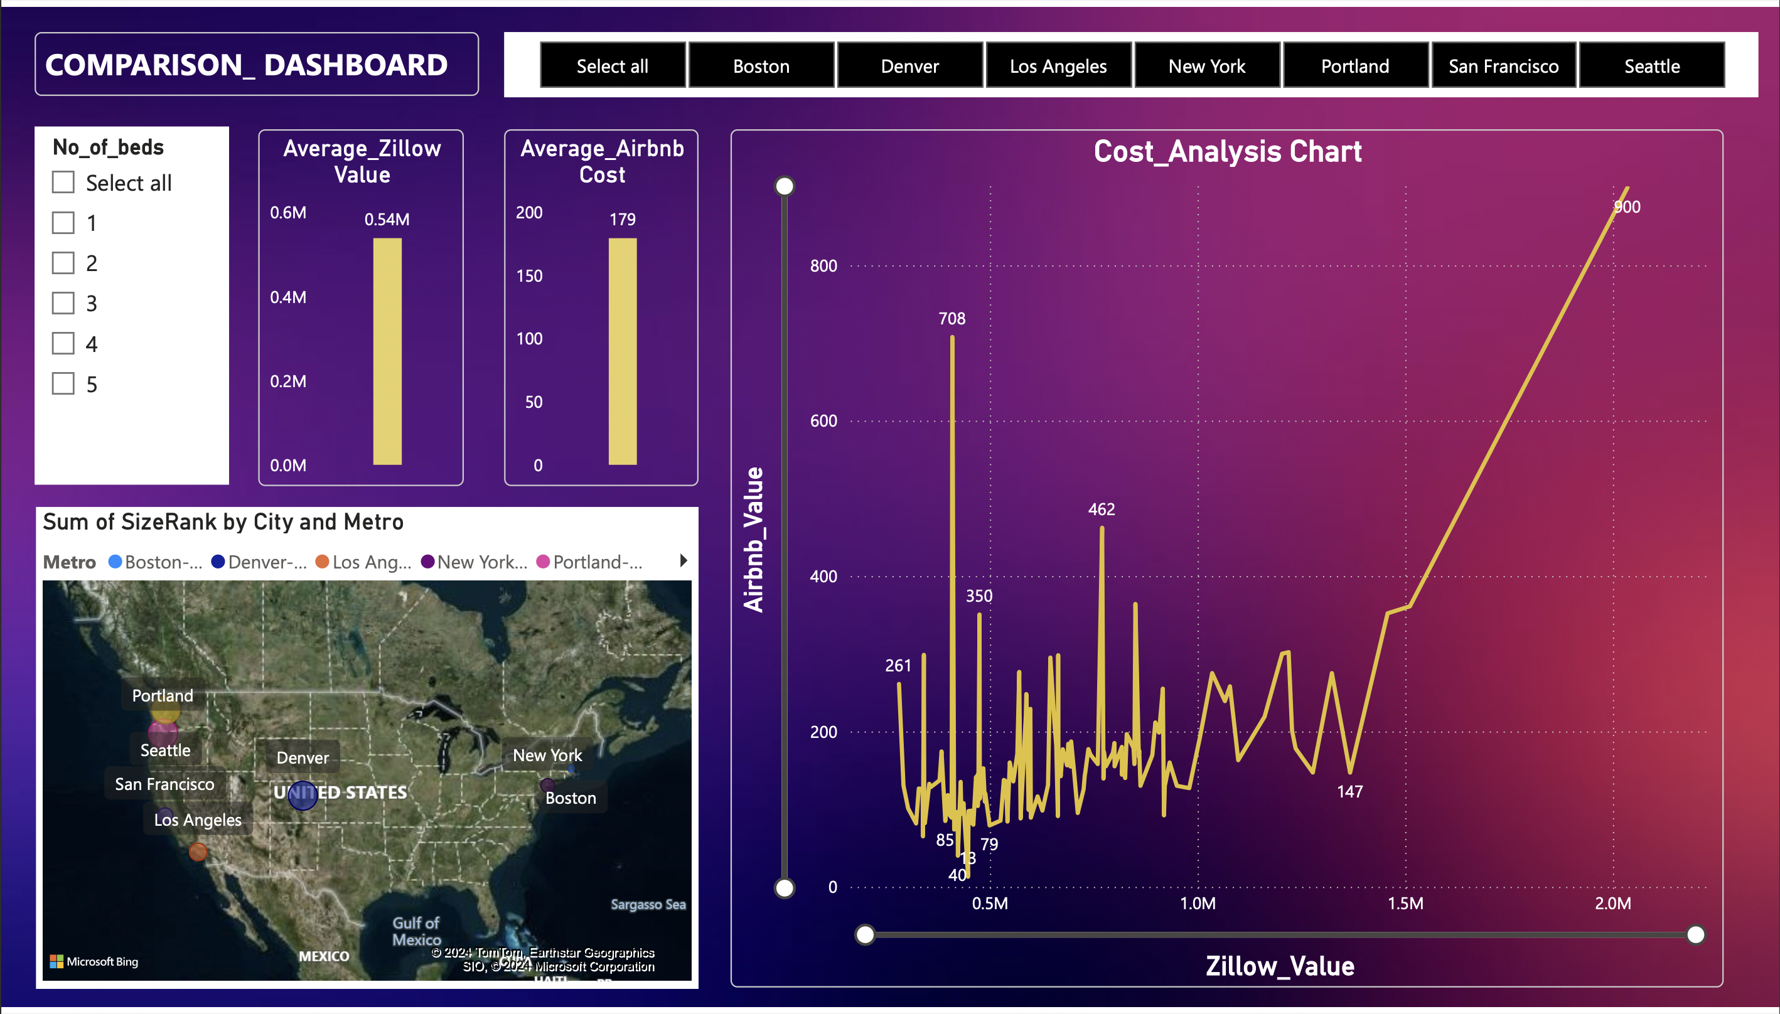
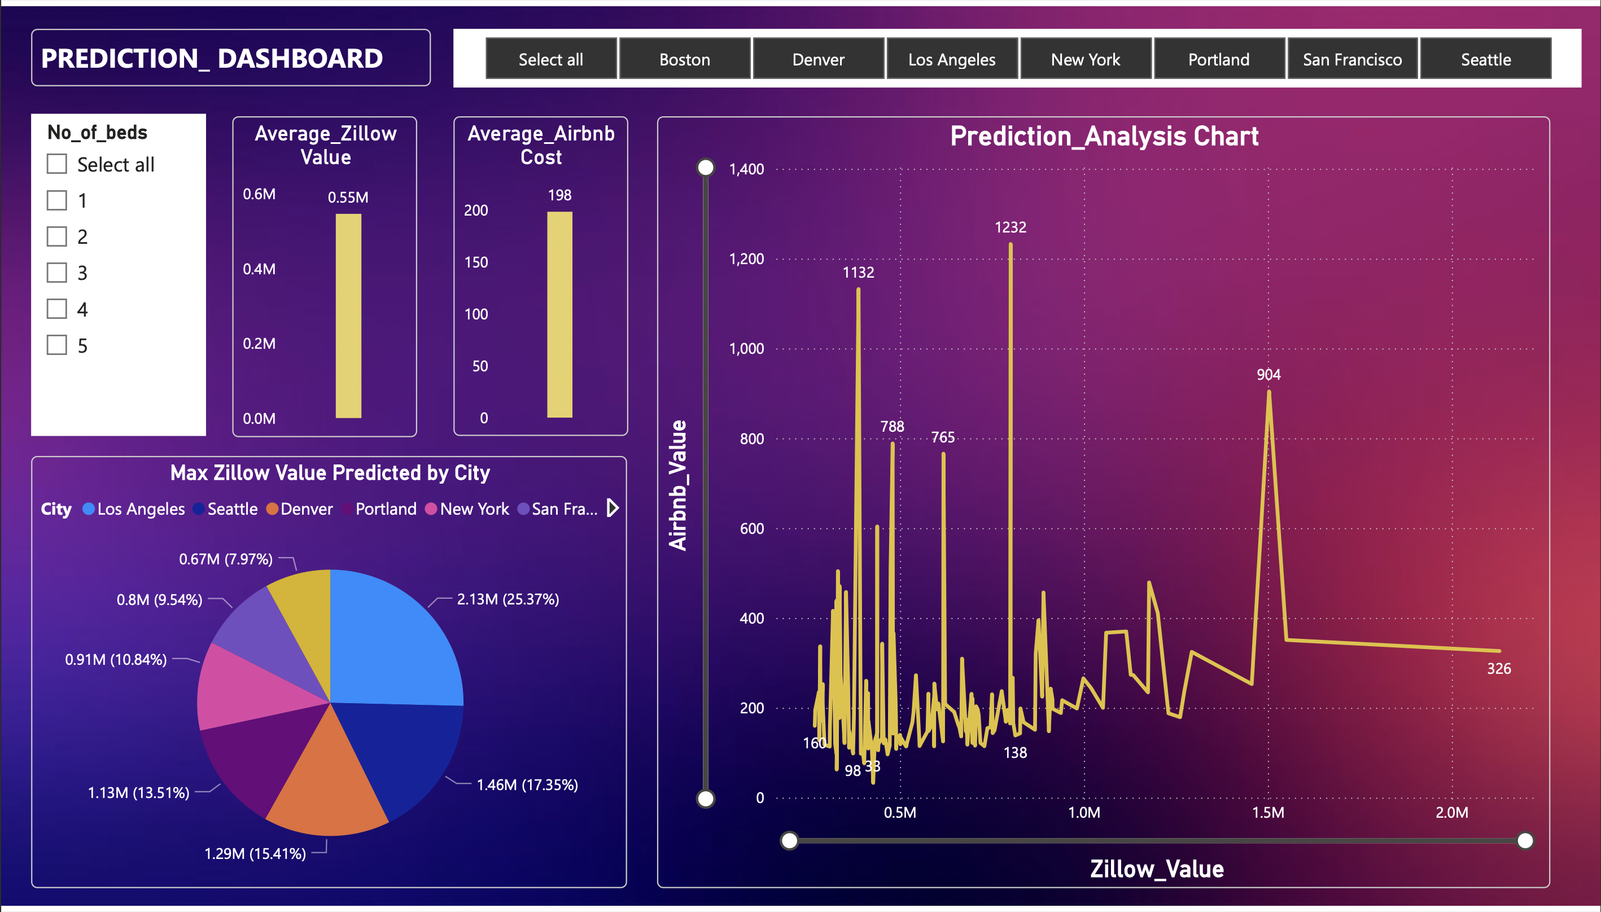
Analyzing and Predicting Trends: A Comparative Study
COMPARISON DASHBOARD: Comparison Dashboard
Allows comparing Airbnb average costs and Zillow average values across different cities and number of beds.
As observed the rent rises along with Zillow value in comparison.
PREDICTION DASHBOARD: Prediction Dashboard
It predicts Zillow Home Value Index on comparison with airbnb to analyze the trend of change between the two values by city.
It shows Los Angeles has the highest predicted maximum Zillow value around $2.13M, while Boston has the lowest around $0.6M.
It also identifies New York as having the highest average Airbnb costs.

Slide 19
Discussions
Airbnb Rental Price Prediction: Implemented various models, with the Random Forest Regressor achieving the best results (MAE: 101.609, R2: 0.333) after thorough preprocessing and hyperparameter tuning.
Zillow Home Value Prediction: Utilized advanced techniques, with the N-Beats model excelling (R2: 0.978, MAE: 24,378.49) in predicting home values.
Model Performance: These models significantly enhanced the project's predictive accuracy and reliability for real estate prices.
Impact: Demonstrated the potential of machine learning in real estate analytics, highlighting the importance of data preprocessing and hyperparameter tuning for optimal performance.

Slide 20
Future Improvements
Data Integration: Explore crime rates, school district information, and transportation data to enrich predictive models.
1
Recommendation System: Develop a personalized investment recommendation system based on user preferences and risk tolerance.
2
Deployment Strategy: Implement scalable deployment strategies for predictive models and dashboards in a production environment.
3

Slide 21
Team Contribution
* All members were involved in all phases of the project
Team Member | Contributions
Mahamaya, Aradhya | Data Collection & EDA, Airbnb Dataset
Shashi, Bhavan | Data Collection & EDA, Zillow Dataset
Mahamaya, Aradhya | Data Pre-processing, Airbnb Dataset
Shashi, Bhavan | Data Pre-processing, Zillow Dataset
Shashi, Bhavan | Model Development, Random Forest Regressor and XG Boost Regressor
Aradhya, Bhavan | Model Development, Linear Regression
Mahamaya, Aradhya | Model Development, N-BEATS and Long-Term Short Memory (LSTM)
Shashi, Mahamaya | Power BI Data Analysis, Zillow and Airbnb Dashboard
Aradhya, Bhavan | Power BI Data Analysis, Comparison and Prediction Dashboard for Airbnb and Zillow Datasets

Slide 22
References
[1] Garlapati, A., Garlapati, K., Malisetty, N., Krishna, D. R., & Narayana, G. (2021). Price listing predictions and forthcoming analysis of Airbnb. 2021 12th International Conference on Computing Communication and Networking Technologies (ICCCNT). https://doi.org/10.1109/icccnt51525.2021.9579773
[2] Peng, N., Li, K., & Qin, Y. (2020). Leveraging Multi-Modality Data to Airbnb price prediction. 2020 2nd International Conference on Economic Management and Model Engineering (ICEMME). https://doi.org/10.1109/icemme51517.2020.00215
[3] Gupta, K., Tayal, D. K., & Jain, A. (2022). An experimental analysis of state-of-the-art Time Series Prediction models. 2022 2nd International Conference on Advance Computing and Innovative Technologies in Engineering (ICACITE). https://doi.org/10.1109/icacite53722.2022.9823455
[4] Yang, Y. (2024). Predicting US Airbnb listing prices by machine learning models. Highlights in Business, Economics and Management, 24, 1408–1417. https://doi.org/10.54097/m187nw17
[5] Lektorov, A., Abdelfattah, E., & Joshi, S. (2023). Airbnb Rental Price Prediction Using Machine Learning Models. 2023 IEEE 13th Annual Computing and Communication Workshop and Conference (CCWC). https://doi.org/10.1109/ccwc57344.2023.10099266
[6] Sinthong, P., & Carey, M. J. (2021). Exploratory Data Analysis with Database-backed Dataframes: A Case Study on Airbnb Data. 2021 IEEE International Conference on Big Data (Big Data). https://doi.org/10.1109/bigdata52589.2021.9671603

Slide 23
Thank you

